Slide 1
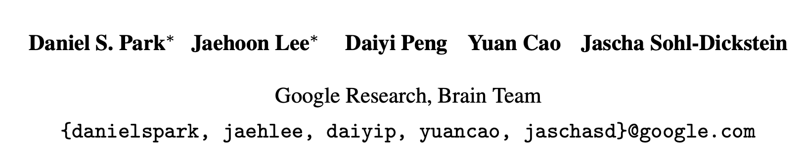
Towards NNGP-guided Neural Architecture Search
https://arxiv.org/pdf/2011.06006.pdf

Slide 2
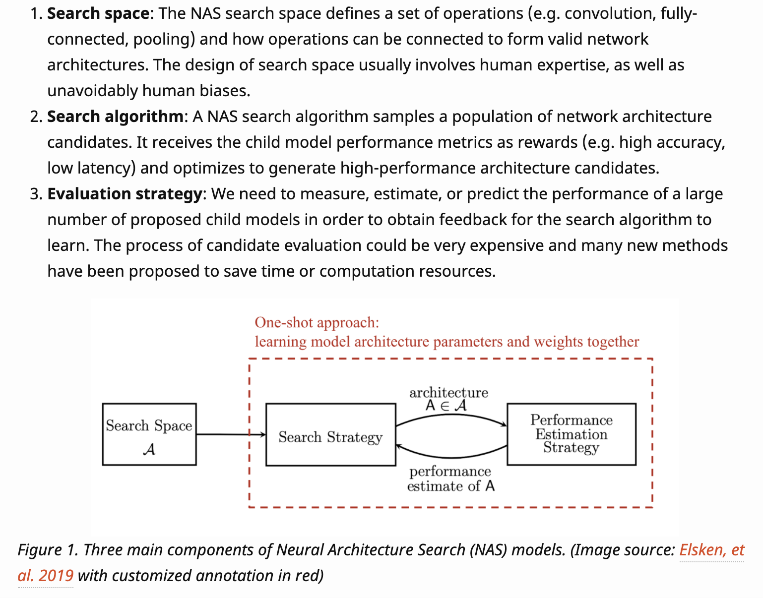
What is NAS?
Neural Architecture Search (NAS) automates network architecture engineering. It aims to learn a network topology that can achieve best performance on a certain task. We can dissect the methods for NAS into three components: search space, search algorithm and child model evolution strategy.
https://lilianweng.github.io/lil-log/2020/08/06/neural-architecture-search.html

Slide 3
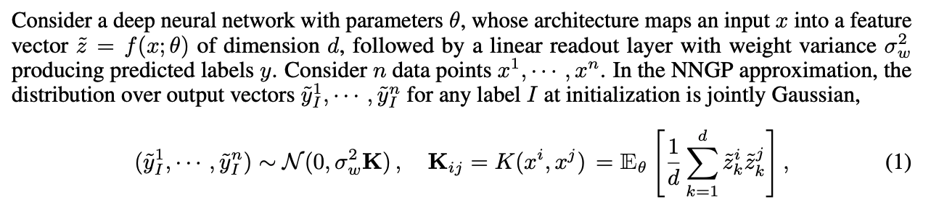
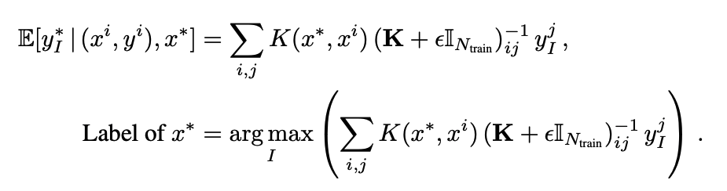
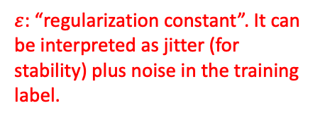
What is NNGP?
Bayesian neural network is essentially equivalent to Gaussian process regression, as the width goes to infinity.
The good thing is that we don’t need to do posterior sampling in the high dimensional parameter space. instead, we can apply analytical posterior formula.
$ε$: “regularization constant”. It can be interpreted as jitter (for stability) plus noise in the training label.

Slide 4
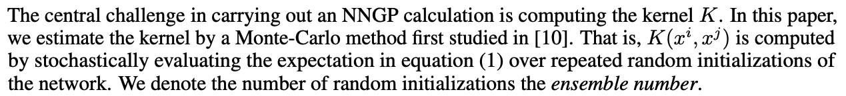
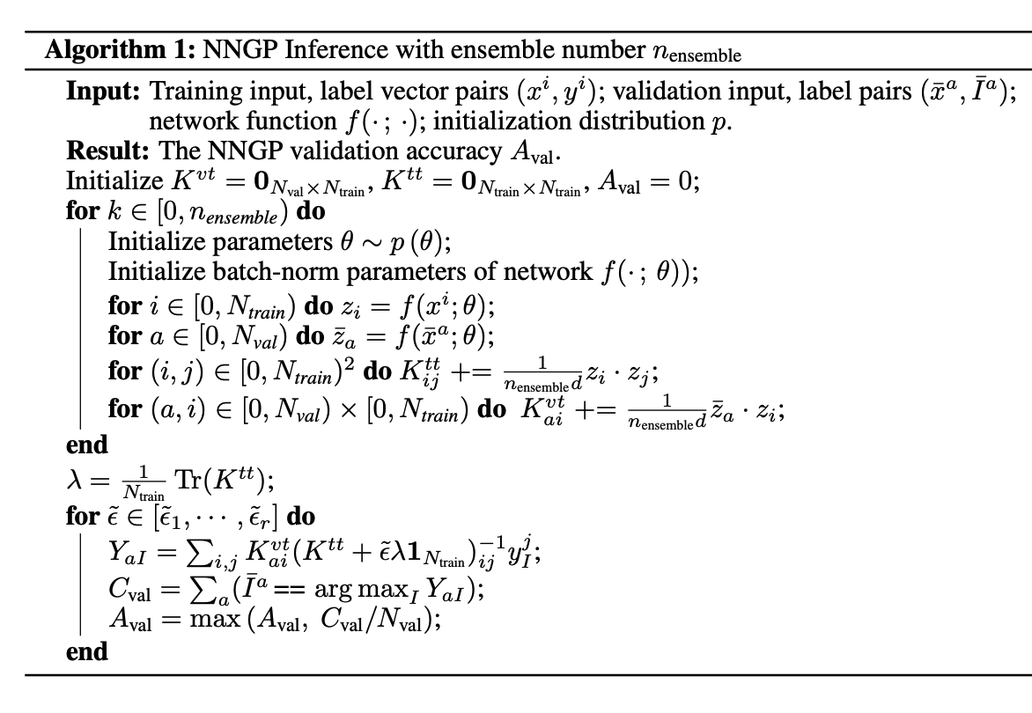


Computational cost for NNGP is cubic w.r.t. training size.
“we cap at 8k samples when computing NNGP accuracy to keep the inference cost reasonable.”
Because they don’t need to train the initialization distribution, so the cost is “reasonable”.
???
Build covariance matrix with Monte Carlo
Search over $ε$, the highest score in validation dataset as validation accuracy

Slide 5
The Key Motivation for Bridging NNGP and NAS
They will use NNGP on validation dataset as an evaluation strategy in NAS. But in the end, they will still use gradient descent on the test dataset to assess the algorithm.
“We expect performance metrics of the NNGP associated with a given network to correlate well with the network’s actual performance after training, since we expect the predictions of Bayesian and gradient descent trained networks to be correlated.”
In other words, we will tell whether a neural network will have a good performance or not, by studying its initialization (in the sense of GP), without a need of training. This will be a cheap evaluation strategy.
Does the expectation make sense?
1, The maximum a posteriori (MAP) estimator of BNN is identical to the global minimizer of loss function + weight regularization.
2, People have been using deep ensemble (basically gradient descent multiple times for independent initializations) as a substitute of BNN. Recently the theory of NTK also bridged gradient descent and BNN.

Slide 6
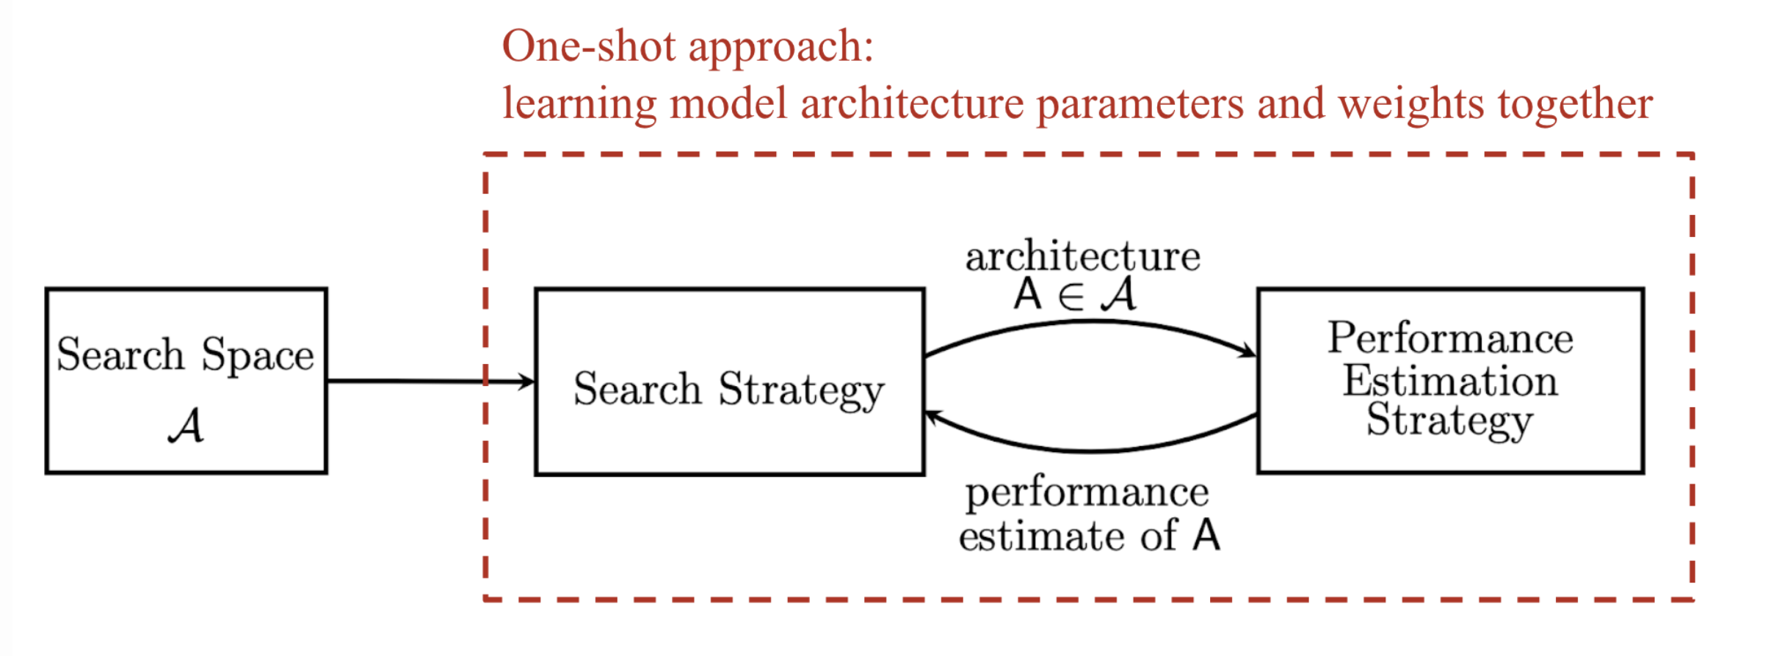
A Summary of Pipeline
1, Apply the search algorithm (from somewhere else) to give an architecture candidate.
2, Apply NNGP on validation dataset to give a performance estimate.
…
Apply gradient descent on test dataset.

Slide 7
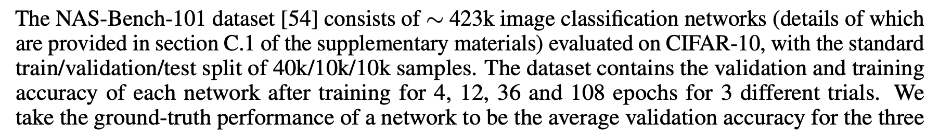
NN Evaluation Benchmark

Slide 8
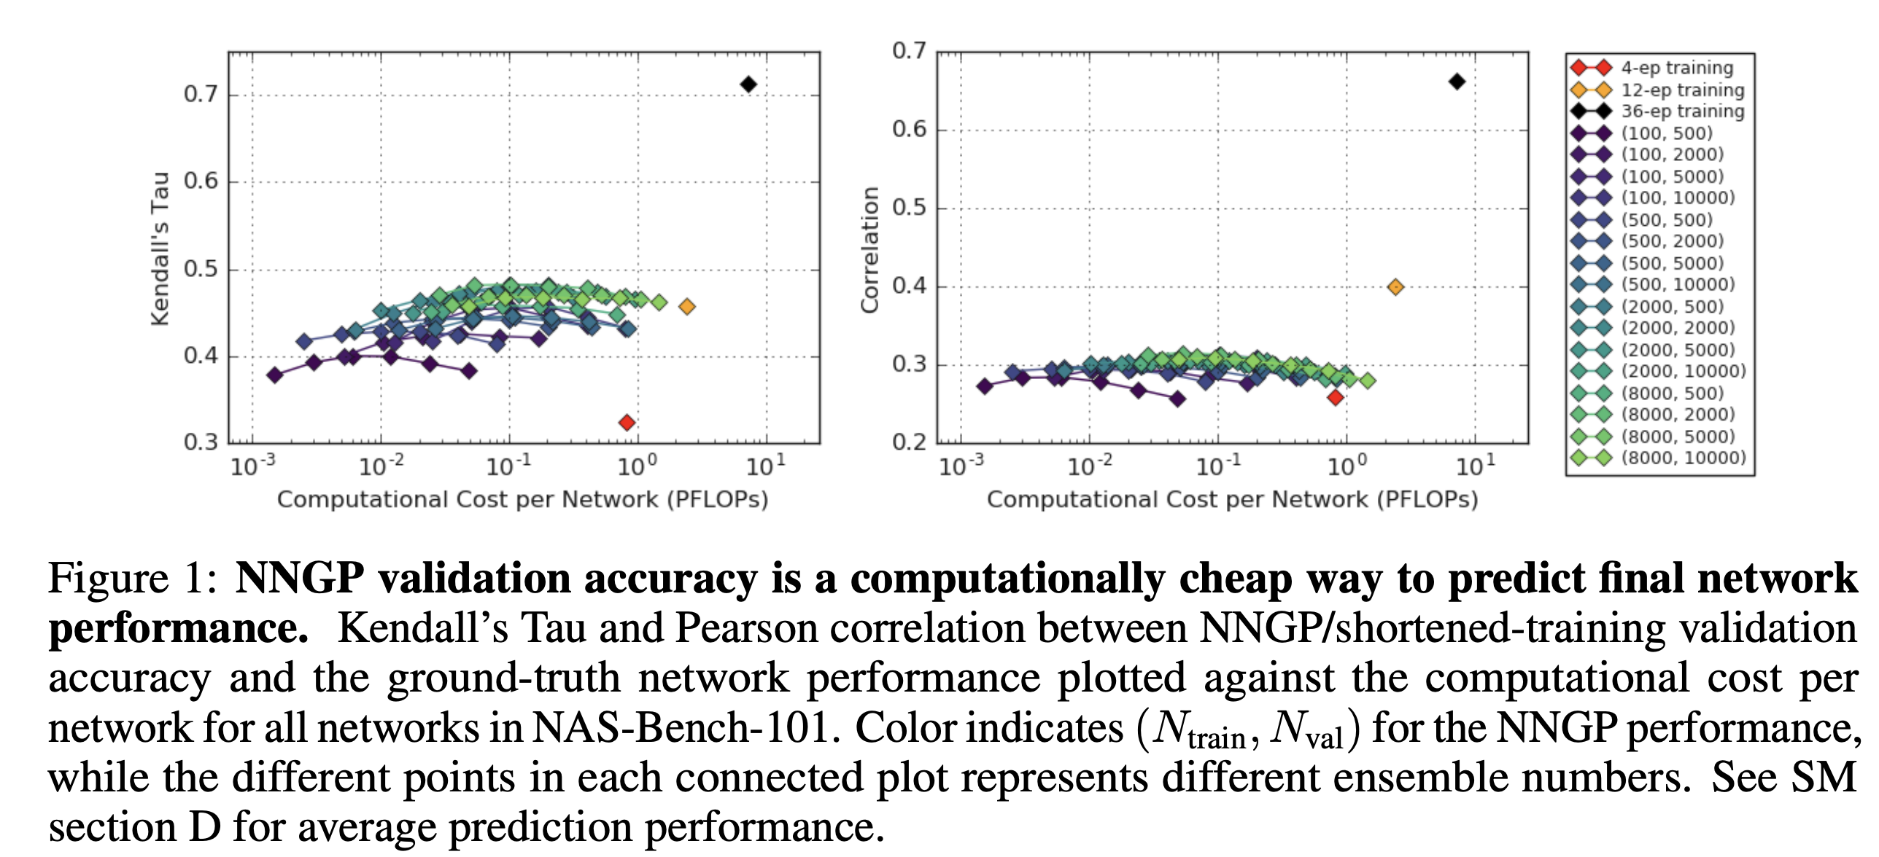
Experiments
The Kendall rank correlation coefficient measures how well the prediction of two orderings agree.

Slide 9
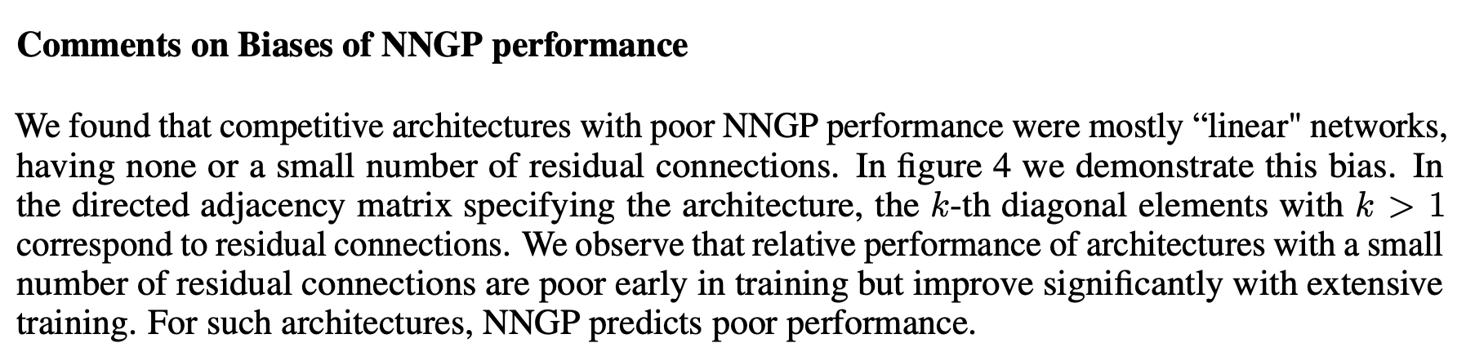
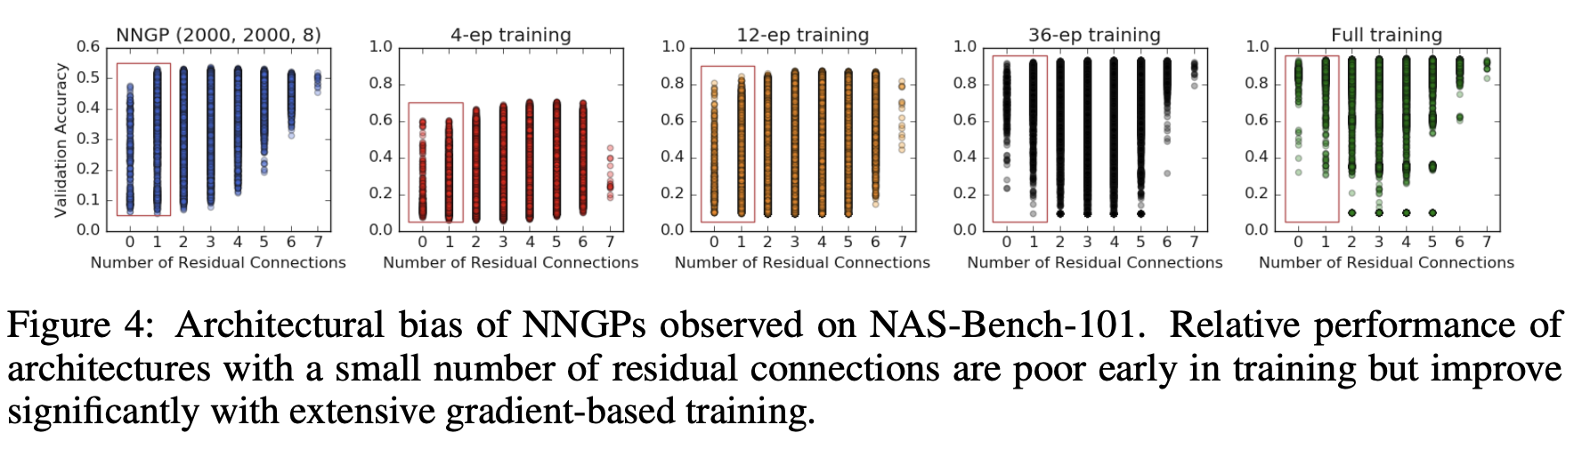
Maybe not Gaussian?

Slide 10
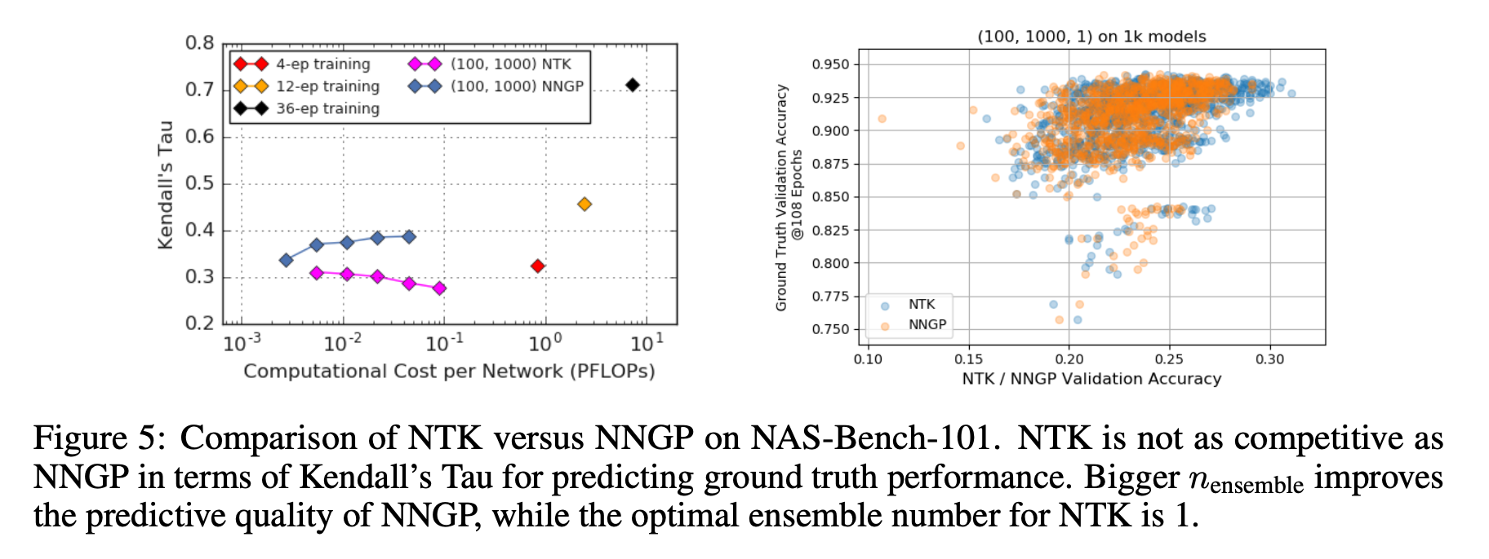
Comments on usage of NTK

Slide 11
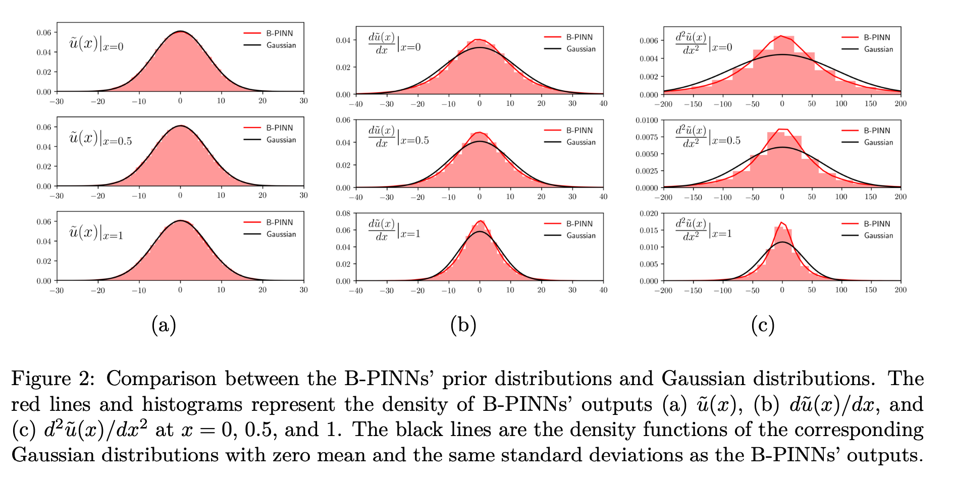
Discussion in the context of PINNs
Can NNGP be used for meta learning for PINNs? Unfortunately, NNGP guided NAS cannot be trivially translated into the context of PINNs.
1, The nonlinearity in PDE will break the Gaussian distribution.
2, Even for linear PDE, we recently found that the derivative of a deep neural network doesn’t converge to Gaussian process as the width goes to infinity. This is a little bit counter-intuitive since the derivative of a GP is still GP. But we remark that taking limit and differentiation is not exchangeable here.
Liu Yang, Xuhui Meng, George Em Karniadakis. B-PINNs: Bayesian Physics-Informed Neural Networks for Forward and Inverse PDE Problems with Noisy Data, Journal of Computational Physics
We are currently working on NAS for B-PINNs. And in the end, we will also discuss if the predictions of Bayesian and gradient descent trained networks are correlated in BPINNs.

Slide 12
Thanks so much!
Have a nice break!
Merry Christmas and Happy New Year!

